Slide 1
Aviation Weather Product Change:
Retiring Legacy CONUS Area Forecasts (FAs), to Utilize Improved NWS Aviation Weather Products and Services
June 15, 2017

Slide 2
Content
Overview of the Change
Aviation Weather Modernization
Why the Area Forecast?
Implementation Milestones
Graphical Forecasts for Aviation (GFA) Tool
Contacts for Questions or Comments

Slide 3
Overview of the Change
On 10 July 2017, a transition period of three (3) months, aimed at ensuring a smooth transition for aviation end-users, will begin. During this time, users will have continued access to legacy FAs while being encouraged to consult the improved aviation weather products and services
On 10 October 2017, the National Weather Service will cease production of six (6) legacy Areas Forecasts (FAs) covering the contiguous United States (CONUS)
FAs for Hawaii, Alaska, the Caribbean, and the Gulf of Mexico remain unaffected at this time. Any potential changes to FAs outside the CONUS will be communicated separately.

Slide 4
Aviation Weather Modernization
Many NWS aviation weather products are decades old, with little change in format
To address this issue, FAA and NWS have undertaken a joint review of weather information produced by NWS for aviation purposes
Primary goals of the review, include:
  Improving NWS products in-support of aviation weather;
  Increasing emphasis on digital products and identifying opportunities to digitize legacy NWS products and services;
  Identifying and removing products and services with duplicative information;
  Identifying and removing products and services of limited utility to aviators; and
  Focusing the activities of NWS forecasters, in order to maximize operational benefit(s).

Slide 5
Why the Area Forecast?
The joint-agency working group recommended the FA be retired in-favor of existing, more-modern digital and graphical forecast products that provide improved weather information to pilots
Limitations of the FA identified by the working group include:
  Unwieldy geographical coverage
  Strict character limitation (legacy teletype requirement)
  Prohibition on describing IFR conditions (reserved for SIGMETs and AIRMETs)
  Update rates significantly less than other, more-modern products and services
While the FA met aviation weather information needs for many years, NWS today provides equivalent (or better) information through a number of alternative products
  Retiring the FA allows the effort of NWS forecasters to be focused on maximizing operational benefit(s) to aviators and other end-users
  Transitioning to more-modern digital and graphical forecasts will provide improved weather information to decision-makers

Slide 6
Implementation Milestones
The joint-agency working group completed an extensive analysis, mapping underlying weather information elements in the FA to more-modern NWS aviation weather products and services
  With few exceptions, the individual weather information elements are available elsewhere in better temporal and/or spatial resolution
Improved NWS aviation weather information was compiled into a Graphical Forecasts for Aviation (GFA) Tool, and made available to aviation end-users and Flight Service briefers
Multiple Safety Risk Assessments addressing the change were completed
A transition period of three (3) months, aimed at ensuring a smooth transition for aviation end-users, will commence 10 July 2017
On 10 October 2017, the National Weather Service will cease production of the six (6) legacy FAs covering the CONUS

Slide 7
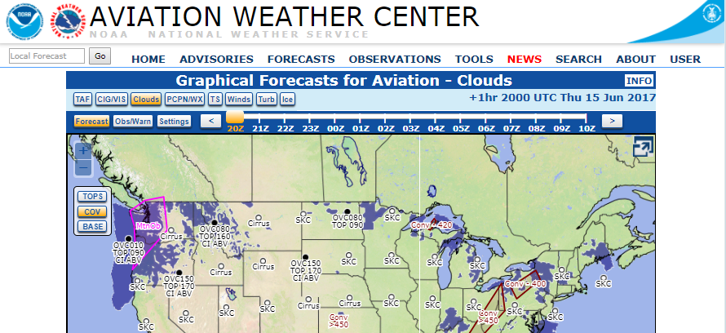
Graphical Forecasts for Aviation Tool
The Graphical Forecasts for Aviation (GFA) Tool can be accessed via the following URL: https://www.aviationweather.gov/gfa

Slide 8
Questions or Comments?
FAA Contact
NWS Contact
Michael ‘Pat’ Murphy
Policy & Requirements Branch
NextGen Aviation Weather Division
Federal Aviation Administration
(202) 267-2788
michael.murphy@faa.gov
Kevin Stone
Aviation and Space Weather Services Branch
Analyze, Forecast and Support Office
National Weather Service
(301) 427-9363
kevin.stone@noaa.gov

Slide 9


NOAA

